Slide 1
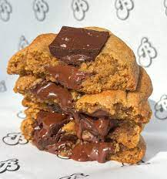
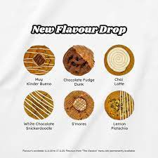
For the First Time Handcrafted Choco revolution .Presenting you revolutionary cookies with six different flavors affordable freshly baked with love and you will indulge in to a journey of happiness
Millennial Millet based cookie
Dropping new Flavors every week

Slide 2
Millennials Cookie Price Survey
Cookies and Chocolates are everyone's delight . For the first time We are launching millets based cookie concept with brand new flavors dropping every single week which is new in this region. This venture - centered around making memories over food ,creating indelible experience .All cookies are handcrafted in our cookie bakery. We are offer ing a box of 6 cookies of different flavor. Currently We are offering Cranberry Pistachio, Cinnamon Hazelnut , Dark Chocolate Sea Salt ,S t r awberry White Chocolate, Date palm jaggery , Ir i sh Coffee flavors .You can order online through Instagram's and Facebook
1 At what price is the product unaffordable?
2 At what price is the product a good bargain?
3 At what price will you buy the product for its quality even if it's not a bargain?
4 At what price is the product too cheap that you start doubting its quality?
1

Slide 3
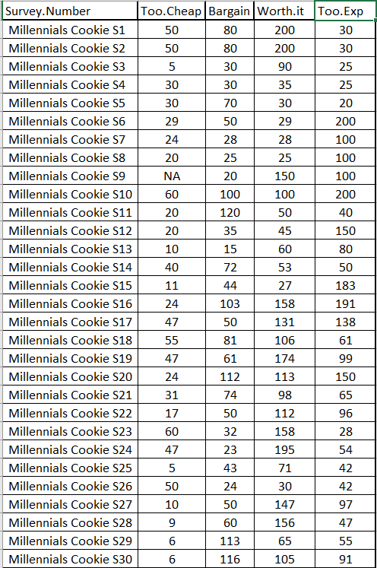

Slide 4
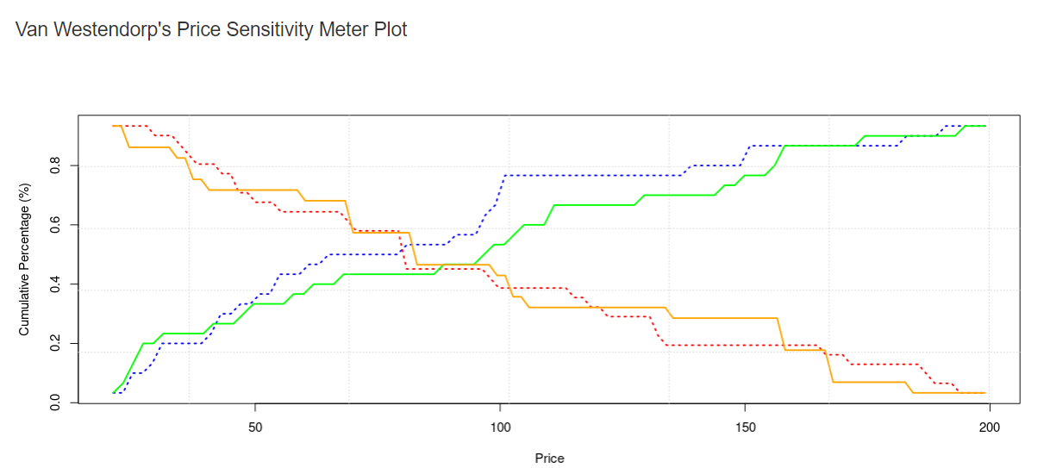
Findings And Conclusion
PMC: point of marginal cheapness is the intersection of green and orange curve = 79
PME: point of marginal expensiveness is the intersection of blue and red curve = 88.
Acceptable price is between 79 - 88

